Slide 1
Banyule Coding Club: Learn Arduino Richard Counsel Malcolm Macleod Watsonia Library - June 2018 Reference materials here -> www.avitech.com.au

Slide 2
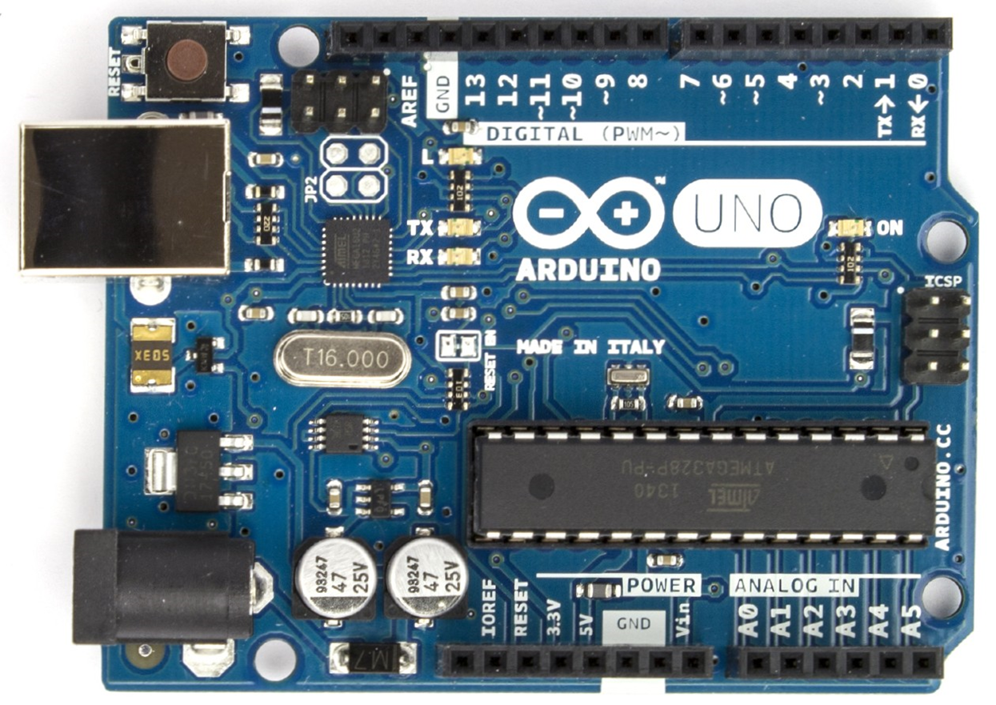
Arduino Uno

Slide 3
What is an Arduino ??
Arduino is an open-source electronics platform based on easy-to-use hardware and software. Arduino boards are able to read inputs - light on a sensor, a finger on a button, or a Twitter message - and turn it into an output - activating a motor, turning on an LED, publishing something online. You can tell your board what to do by sending a set of instructions to the microcontroller on the board. To do so you use the Arduino programming language … and the Arduino Software
https://www.arduino.cc/en/Guide/Introduction

Slide 4
Why Arduino ??
Open source hardware and software
Experimenting, hacking and developing
Artists, designer, students, engineers
Lots of free community resources
Very expandable
Inexpensive

Slide 5
How many models are there?
https://www.arduino.cc/en/Main/Products
Recommended starting point:
Arduino Uno (standard product)
Arduino Mega (extra I/O pins)
Arduino Nano (small footprint)

Slide 6
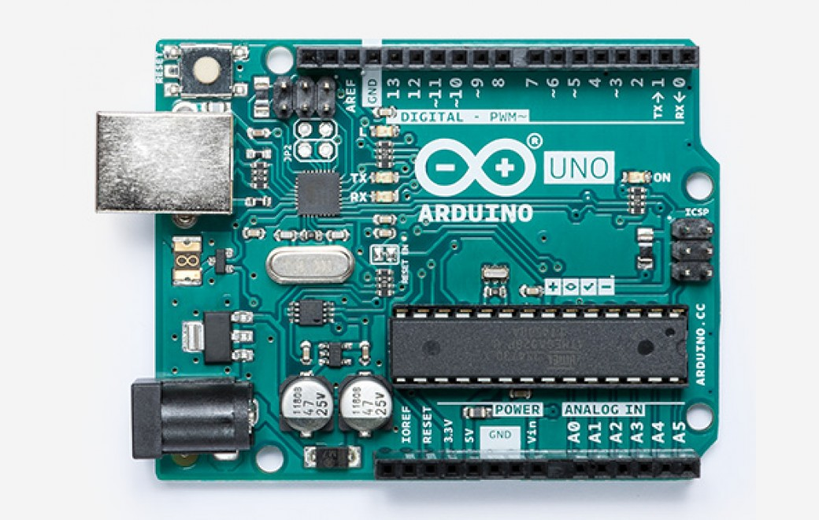
Arduino Uno https://store.arduino.cc/arduino-uno-rev3
eBay: Approximately A$6 from Hong Kong (30 days delivery) or A$12 locally

Slide 7
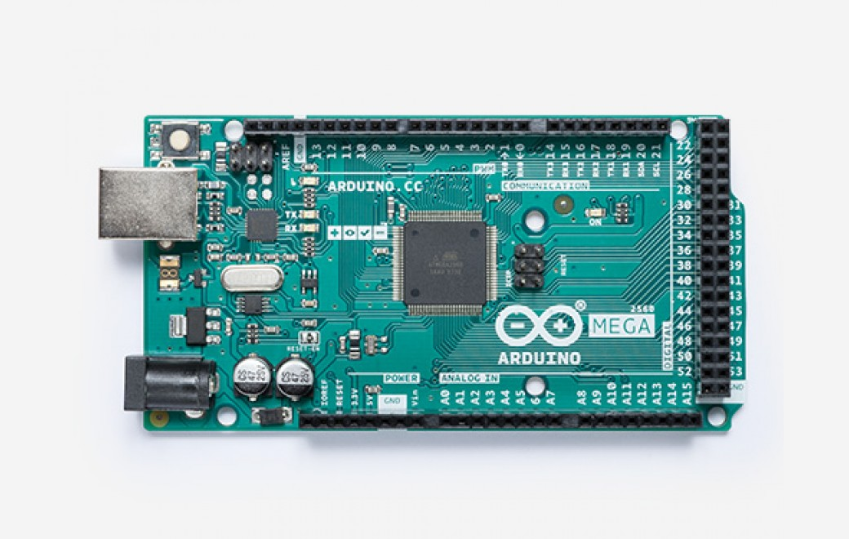
Arduino Mega https://store.arduino.cc/arduino-mega-2560-rev3
eBay: Approximately A$15 from China (30 days delivery) or A$30 locally

Slide 8
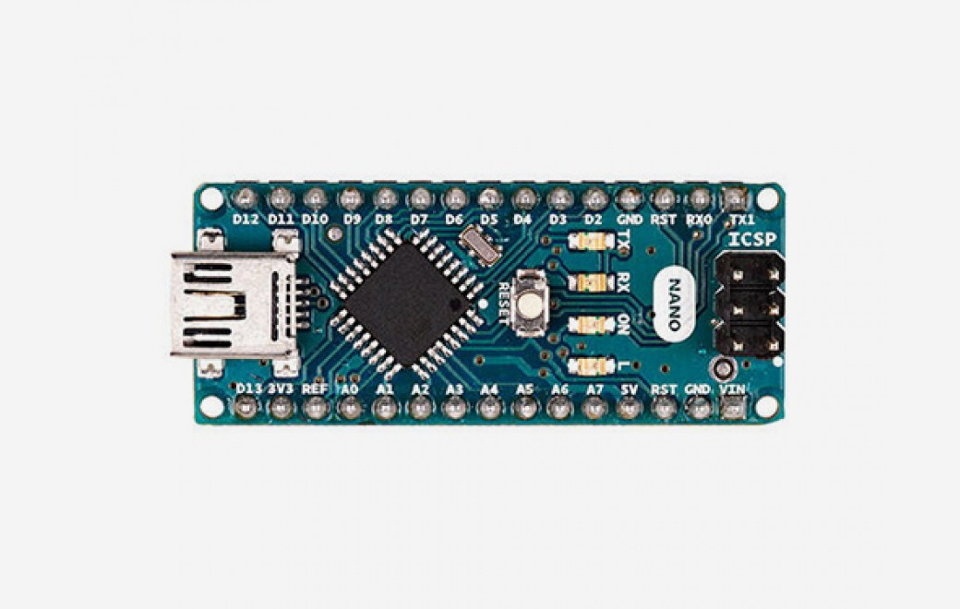
Arduino Nano https://store.arduino.cc/arduino-nano
eBay: Approximately A$5 from China (30 days delivery) or A$9 locally

Slide 9
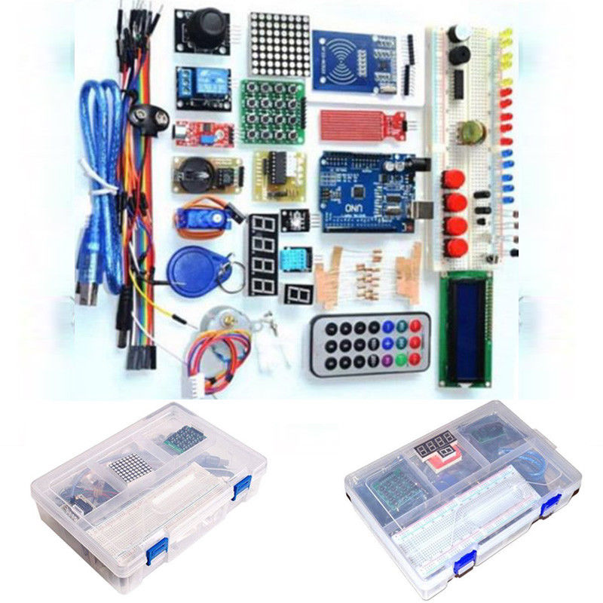
Starter Kit https://www.ebay.com.au/itm/202335369273?ViewItem=&item=202335369273
eBay: Approximately A$36 from China

Slide 10
Getting Started
Buy an Arduino board
Download the “Arduino IDE” software
Connect the board to your PC via USB
In the Arduino IDE software:
Select your board type
Select you COM port
Type in your “Sketch”
Compile and Download

Slide 11
Resources
Download the “Arduino IDE” software:
https://www.arduino.cc/en/Main/Software
Get “Introduction to Arduino” textbook:
https://www.introtoarduino.com/downloads/IntroArduinoBook.pdf
Further notes about these workshops:
http://avitech.com.au/?page_id=3325

Slide 12
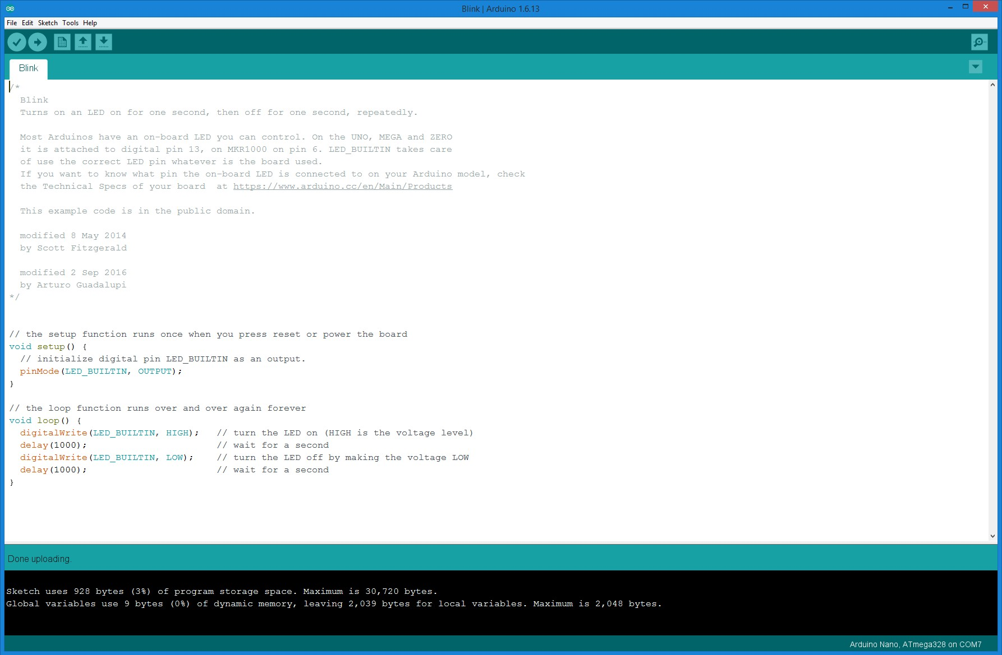
Arduino IDE

Slide 13
First Project: Hello World
Open the Arduino IDE software
Select File -> Examples -> 01. Basics -> Blink
Select Tools -> Board -> [Board Type]
Select Tools -> Port -> [COM Port]
Click “Upload” (right arrow) button
Watch the on-board LED flash!
Modify the “delay(x)” parameters and upload again

Slide 14
More “Getting Started” Projects
LED Chaser (Chapter 2.8, Listing 2.5)
Potentiometer (Chapter 3.2, Listing 3.5)
Simple Note (Chapter 4.2)
Music with functions (Chapter 4.4)

